Slide 1
CSE408 Minimum Spanning Tree(Prims,Kruskshal)
Lecture #26

Slide 2
Minimum Spanning Tree
A minimum spanning tree connects all nodes in a given graph
A MST must be a connected and undirected graph
A MST can have weighted edges
Multiple MSTs can exist within a given undirected graph

Slide 3
More about Multiple MSTs
Multiple MSTs can be generated depending on which algorithm is used
If you wish to have an MST start at a specific node
However, if there are weighted edges and all weighted edges are unique, only one MST will exist

Slide 4
Real Life Application of a MST
A cable TV company is laying cable in a new neighborhood. If it is constrained to bury the cable only along certain paths, then there would be a graph representing which points are connected by those paths. Some of those paths might be more expensive, because they are longer, or require the cable to be buried deeper; these paths would be represented by edges with larger weights. A minimum spanning tree would be the network with the lowest total cost.

Slide 5
Prim’s Algorithm
Initially discovered in 1930 by Vojtěch Jarník, then rediscovered in 1957 by Robert C. Prim
Similar to Dijkstra’s Algorithm regarding a connected graph
Starts off by picking any node within the graph and growing from there

Slide 6
Prim’s Algorithm Cont.
Label the starting node, A, with a 0 and all others with infinite
Starting from A, update all the connected nodes’ labels to A with their weighted edges if it less than the labeled value
Find the next smallest label and update the corresponding connecting nodes
Repeat until all the nodes have been visited

Slide 7
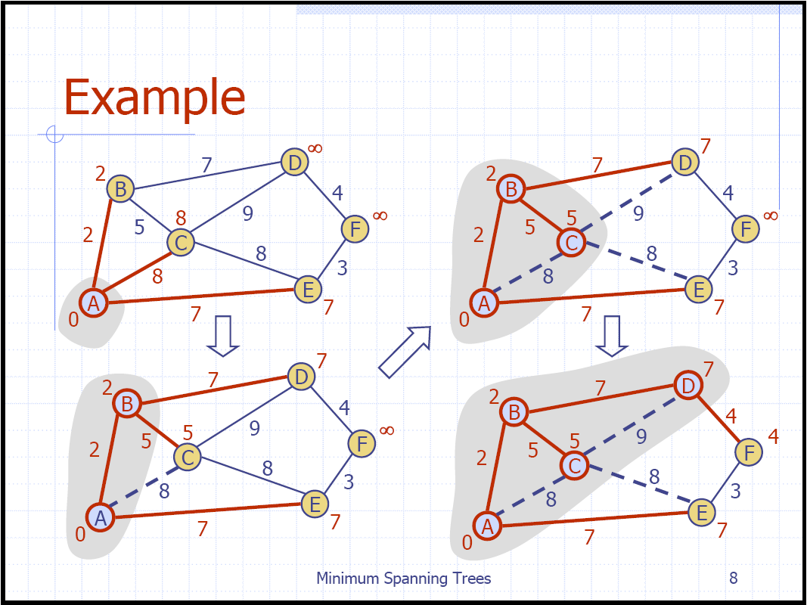
Prim’s Algorithm Example

Slide 8
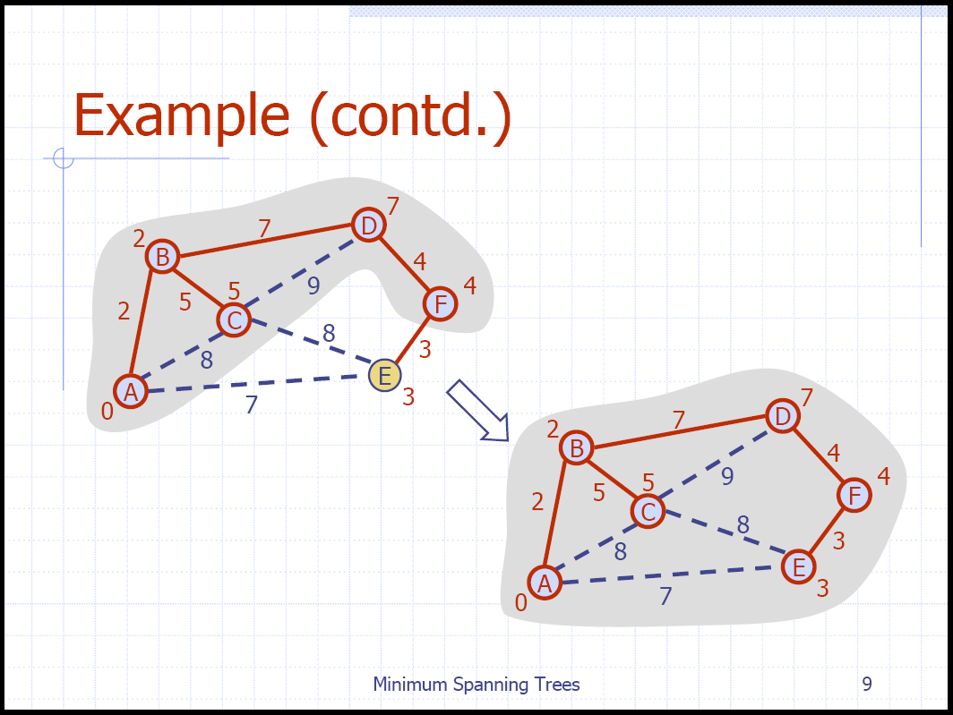
Prim’s Algorithm Example

Slide 9
Kruskal’s Algorithm
Created in 1957 by Joseph Kruskal
Finds the MST by taking the smallest weight in the graph and connecting the two nodes and repeating until all nodes are connected to just one tree
This is done by creating a priority queue using the weights as keys
Each node starts off as it’s own tree
While the queue is not empty, if the edge retrieved connects two trees, connect them, if not, discard it
Once the queue is empty, you are left with the minimum spanning tree

Slide 10
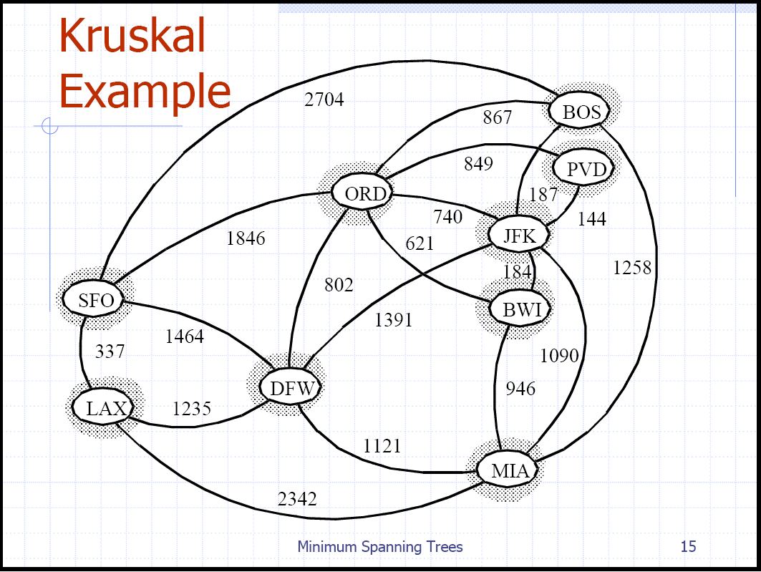
Kruskal’s Algorithm Example

Slide 11
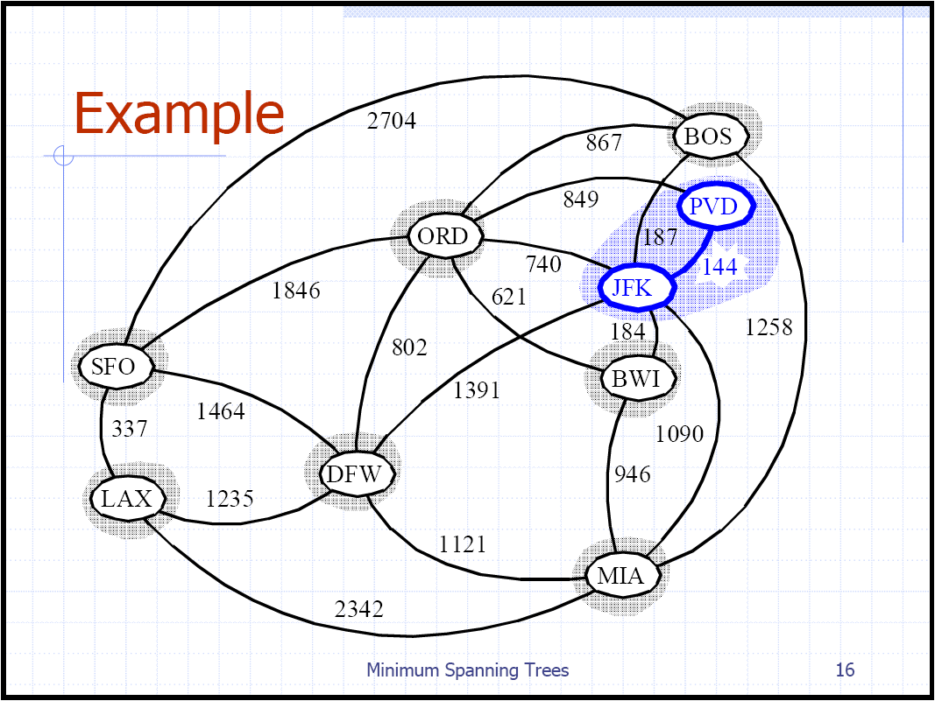
Kruskal’s Algorithm Example

Slide 12
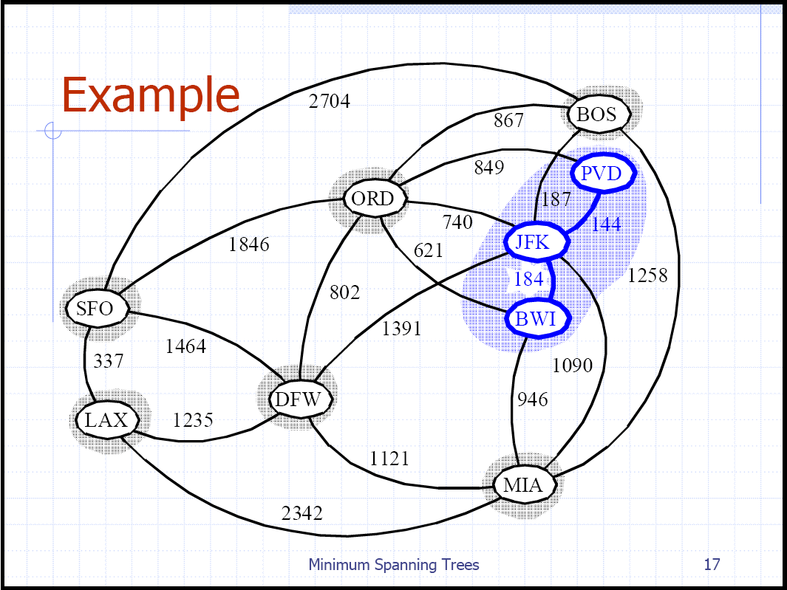
Kruskal’s Algorithm Example

Slide 13
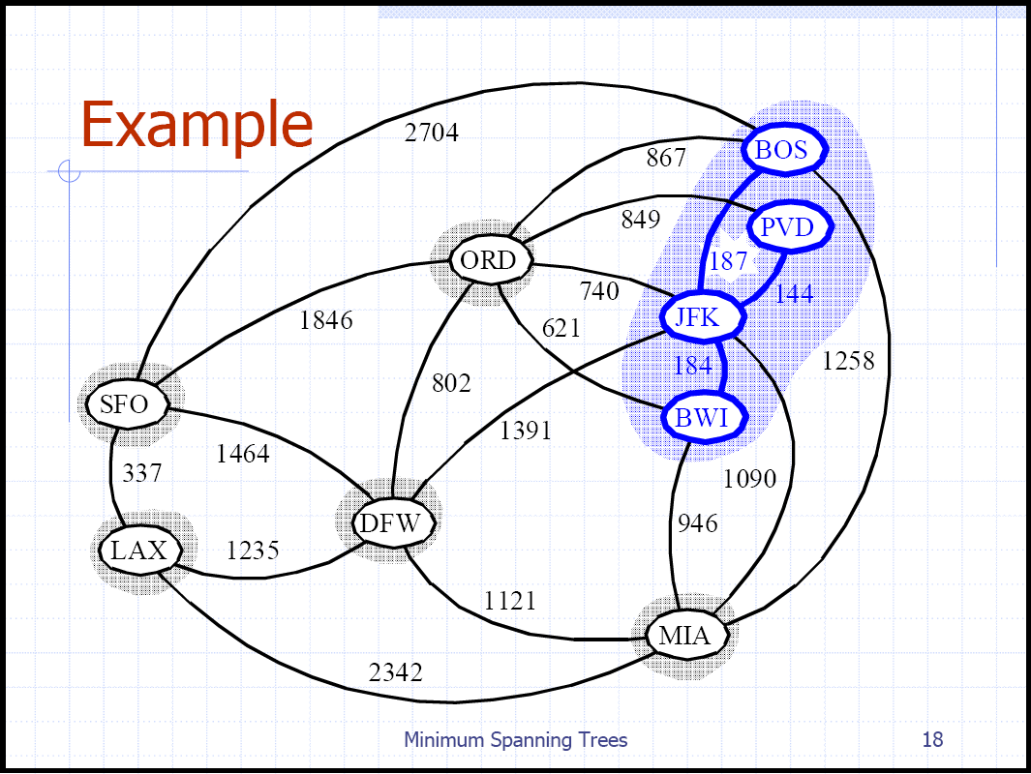
Kruskal’s Algorithm Example

Slide 14
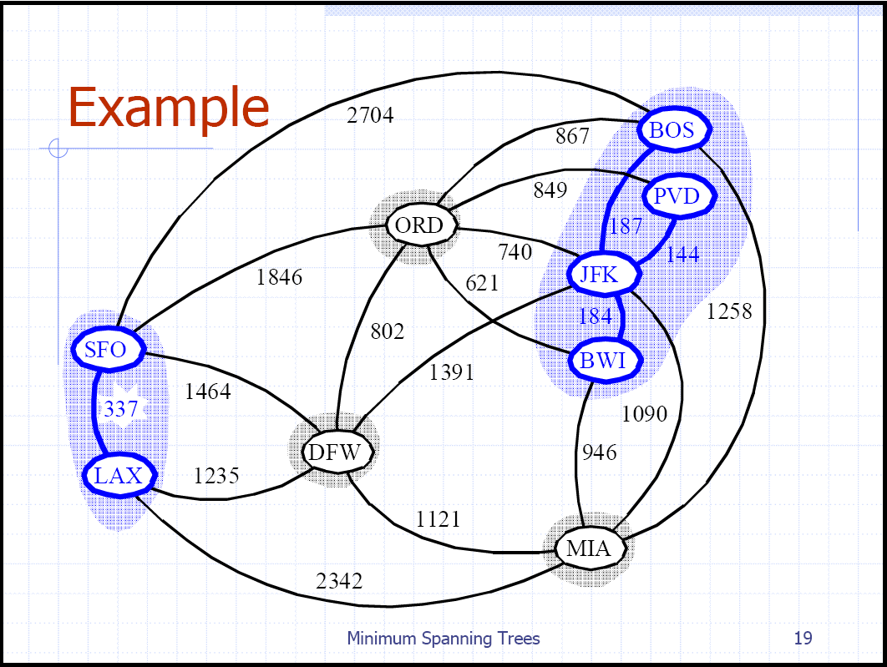
Kruskal’s Algorithm Example

Slide 15
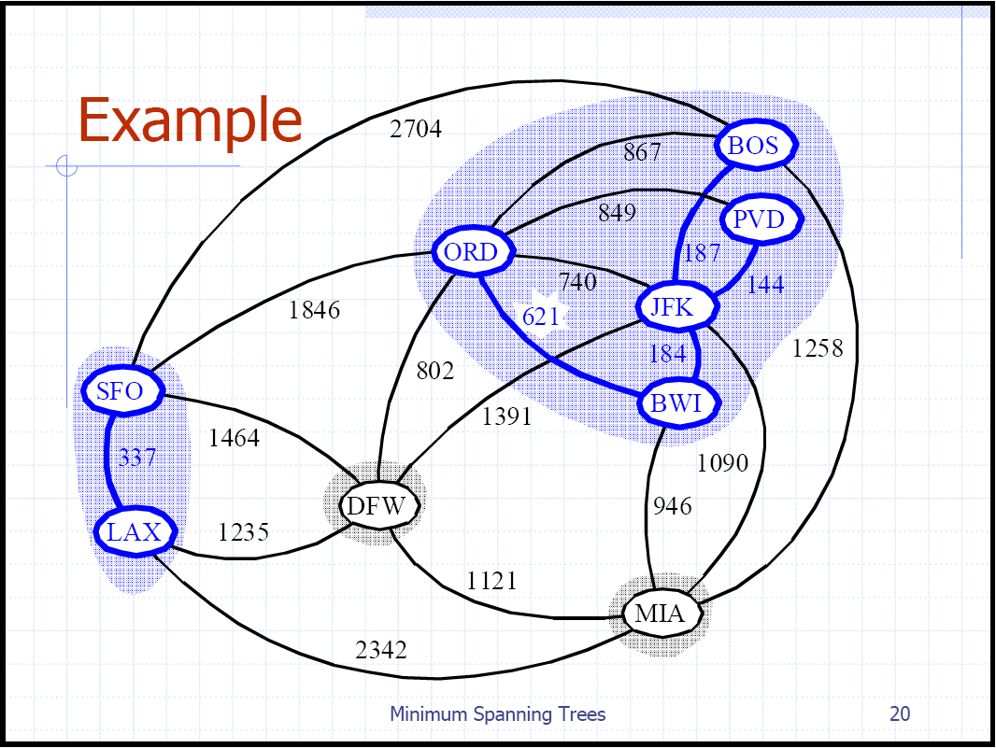
Kruskal’s Algorithm Example

Slide 16

Kruskal’s Algorithm Example

Slide 17
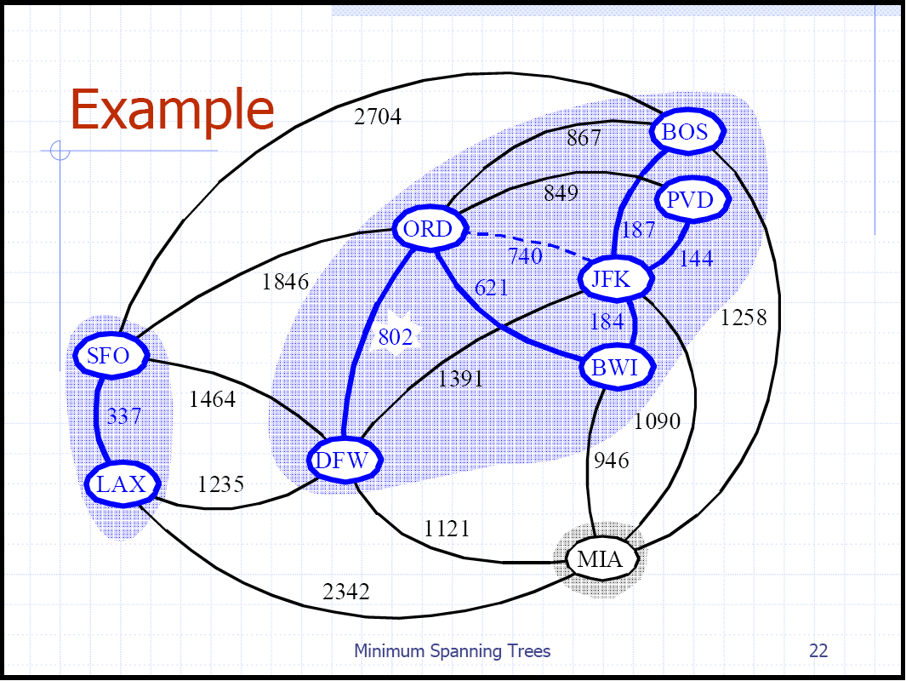
Kruskal’s Algorithm Example

Slide 18
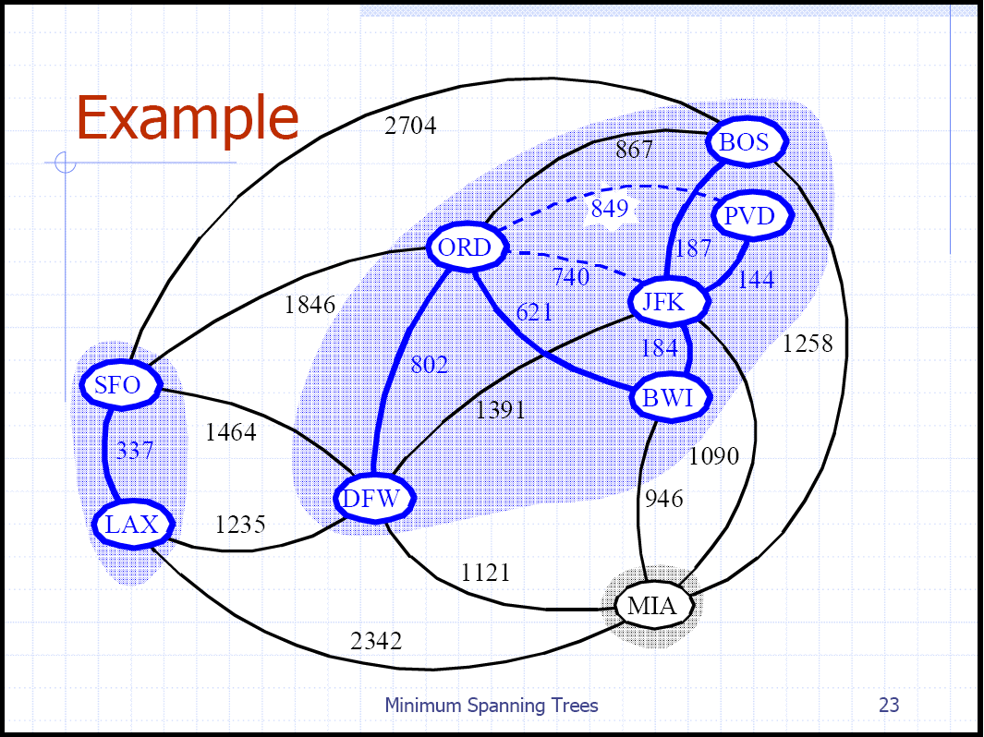
Kruskal’s Algorithm Example

Slide 19
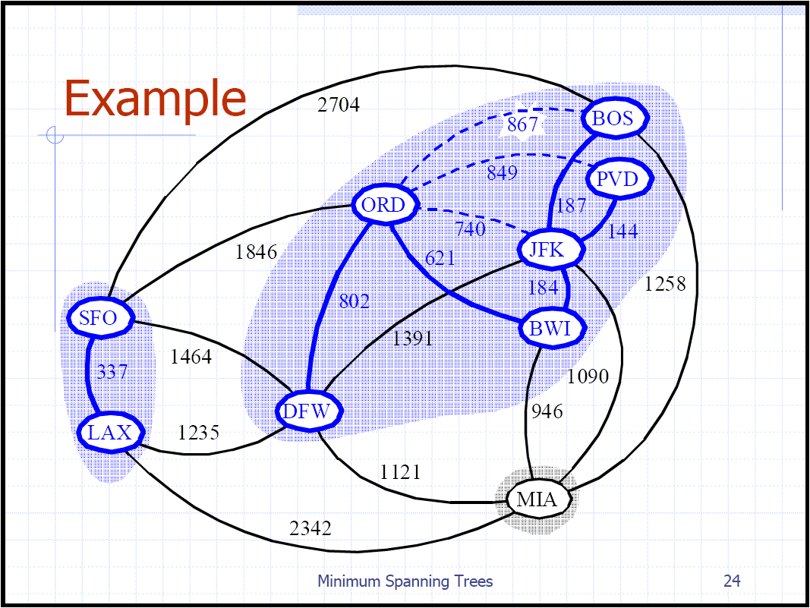
Kruskal’s Algorithm Example

Slide 20
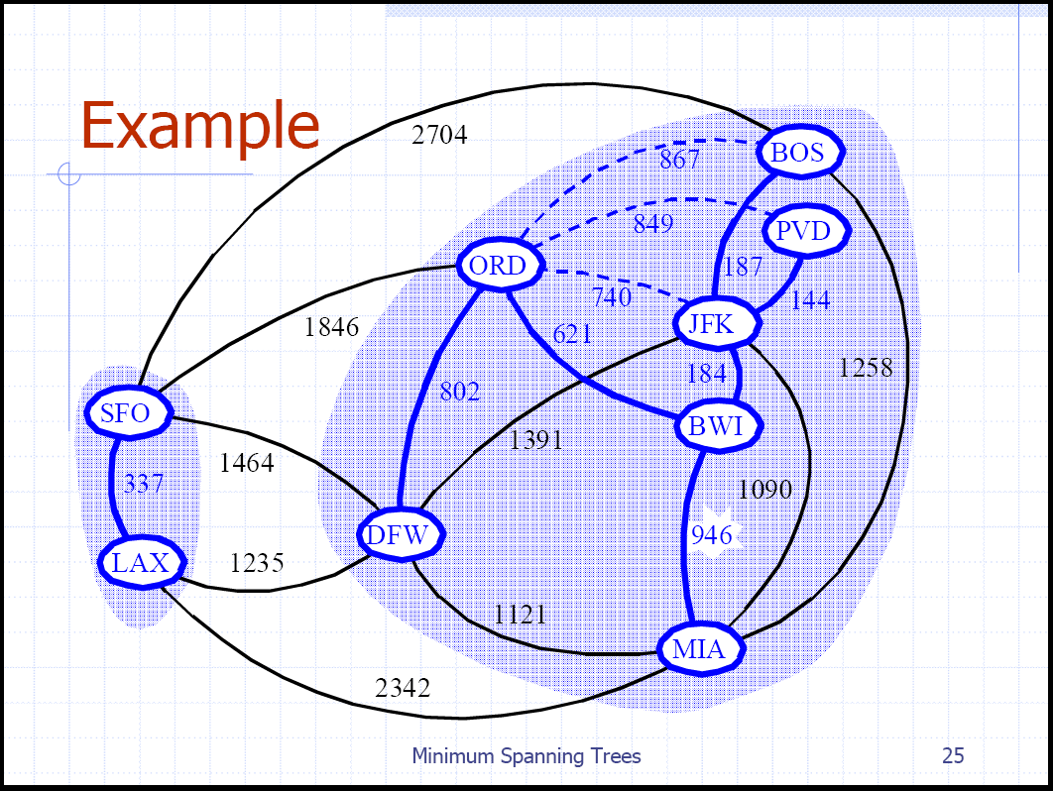
Kruskal’s Algorithm Example

Slide 21
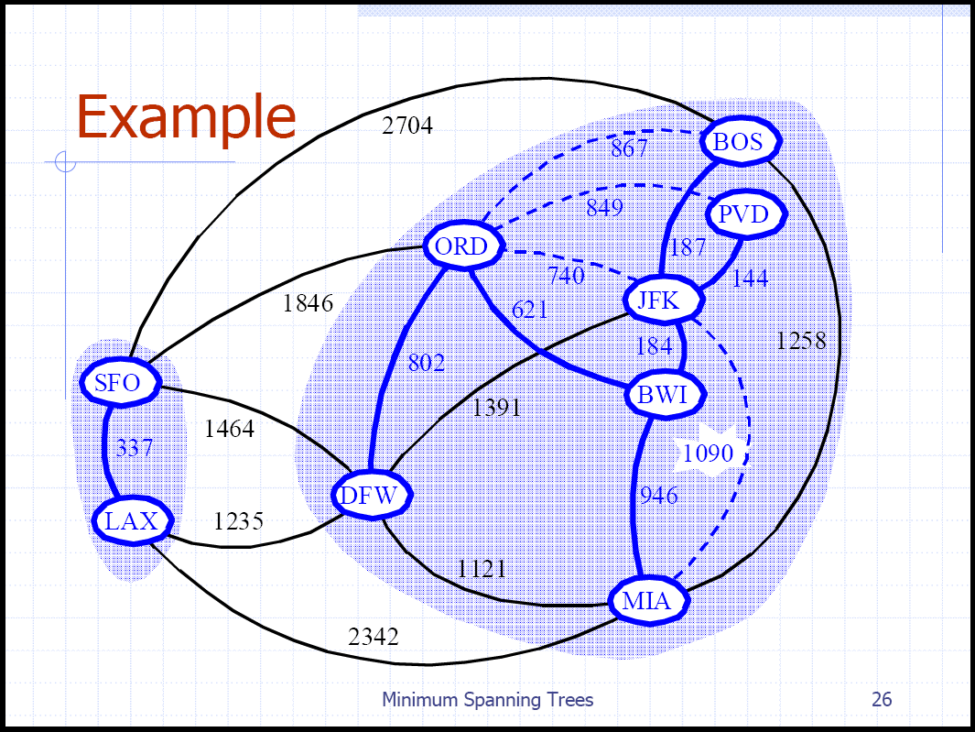
Kruskal’s Algorithm Example

Slide 22
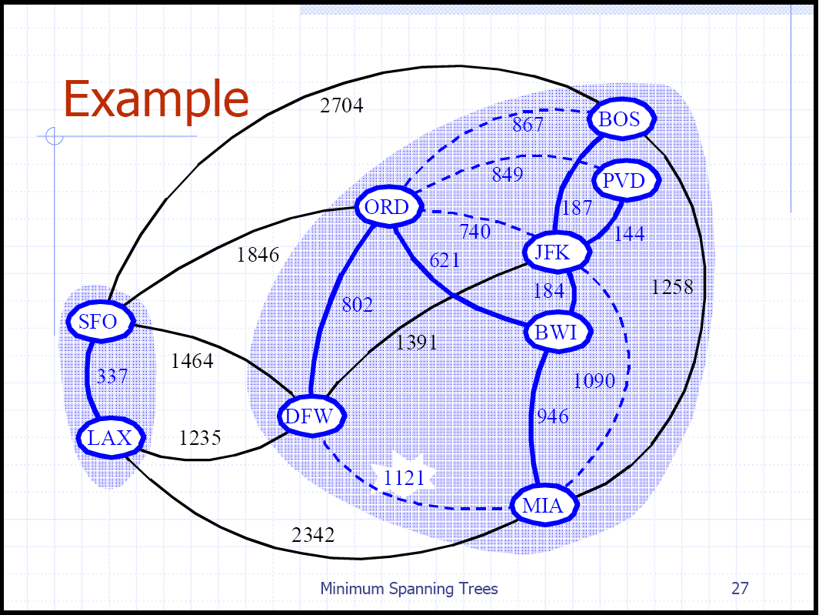
Kruskal’s Algorithm Example

Slide 23
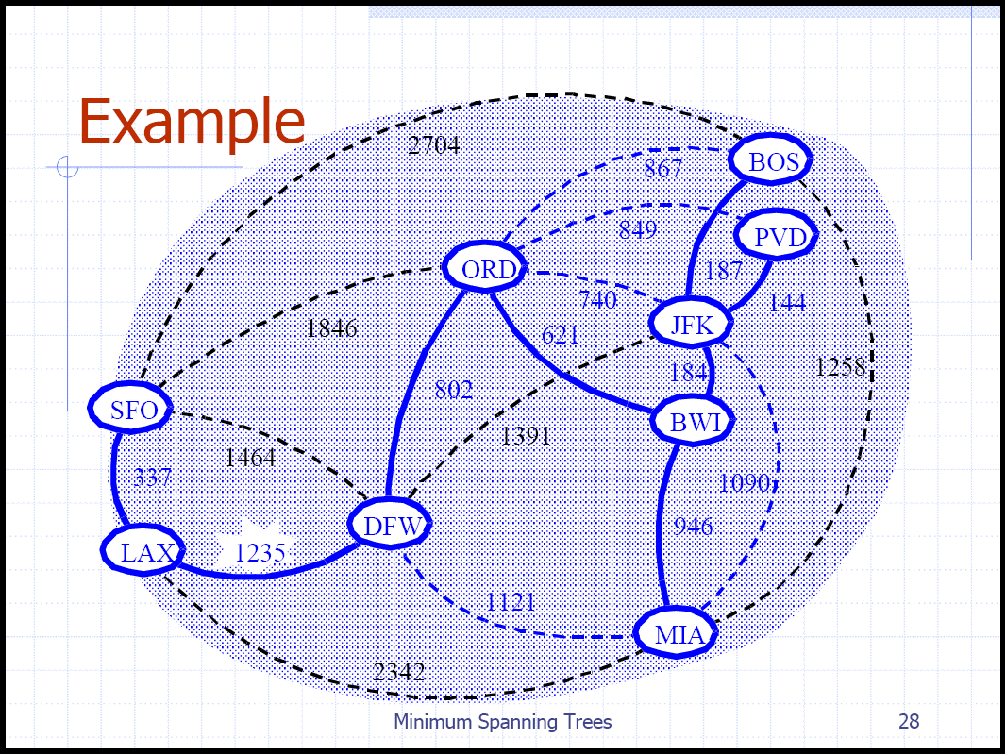
Kruskal’s Algorithm Example

Slide 24
Thank You !!!

